Slide 1
Wireframe Document
BANK MARKETING ANALYSIS
KRISHNA BIRADAR

Slide 2
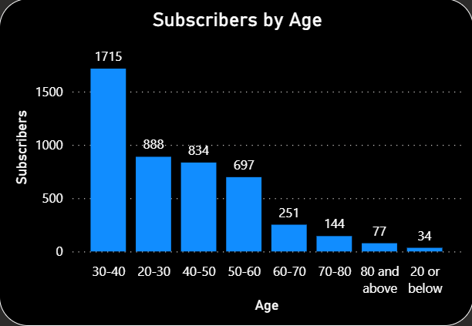
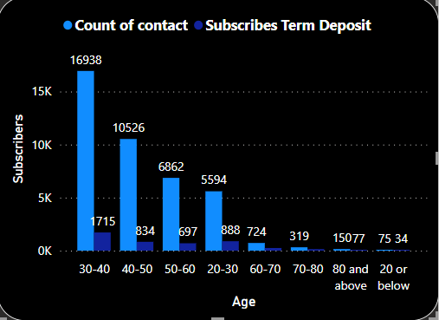
Wireframe Document
1. Age range of the people who subscribed to term deposit
2. Depicts total people contacted vs people who subscribed term deposit.

Slide 3
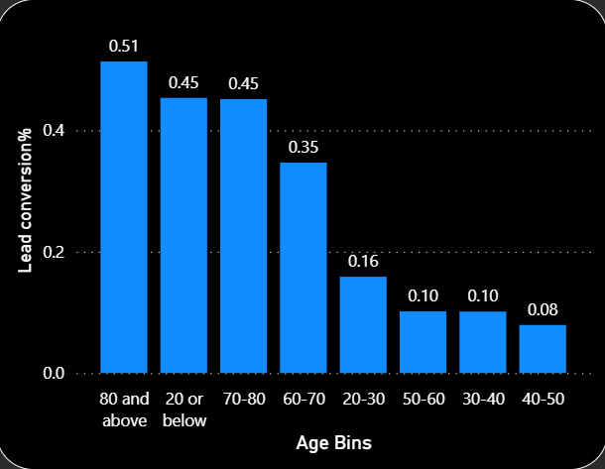
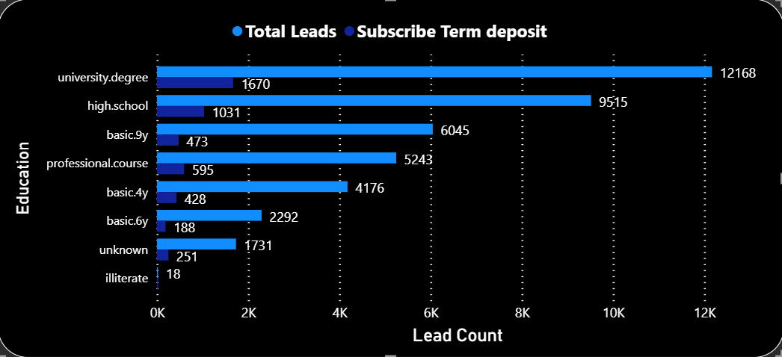
Wireframe Document
3. Leads Conversion of Term Deposit market Campaign based on Customer’s age.
4. Education status of Total Customers and Customers who subscribed to terms deposit.

Slide 4
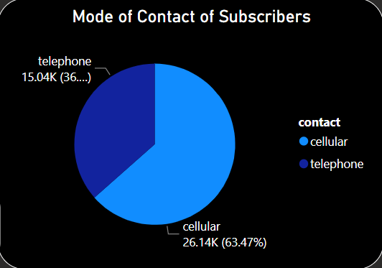
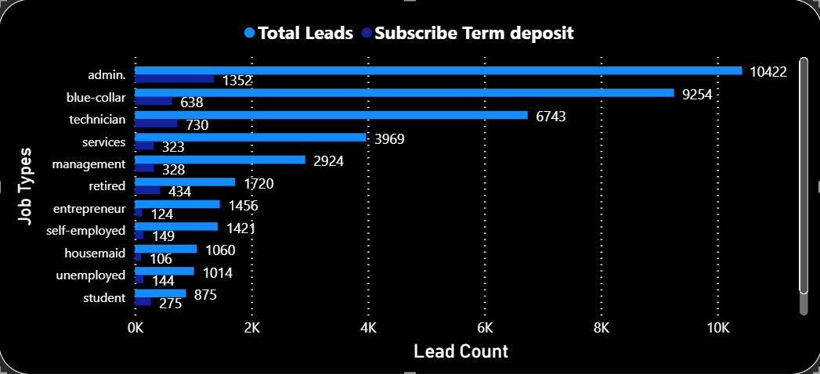
Wireframe Document
5. Marital Status of Customers who subscribed to term deposits.
6. Depicts the type of jobs, Customers are into.

Slide 5
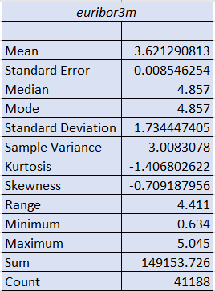
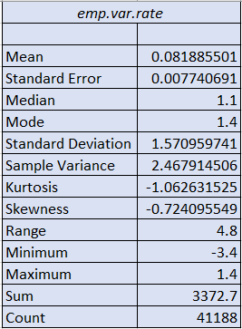
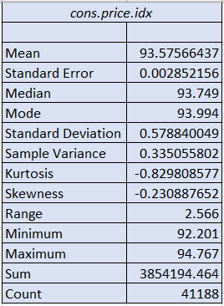
Wireframe Document
7. Euribor 3 months Index Description.
8. Employee variability rate description.
9. Consumer Price Index description.

Slide 6
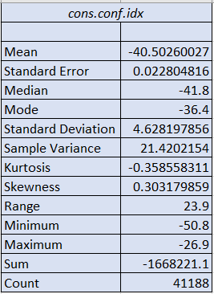
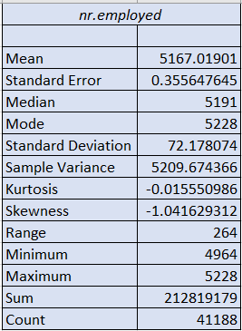
Wireframe Document
10. Consumer Confidence Index Description
11. Number of employees description.

Slide 7
Wireframe Document
INSIGHTS
Insight 1: People who work in Administration, technician and Blue-collar jobs subscribe to term deposit the most.
Insight 2: People who are entrepreneur, unemployed or housemaid subscribe to term deposit the least. Insight 3: Students, retired and unemployed are easiest to get whereas entrepreneur,
blue-collar and service people are difficult to get subscribed.
Insight 4: Conversion rate of married people is higher than the single and divorced people.
Insight 5: Customers who have either University degree or went High school or have enrolled in professional course subscribed the term deposits most.
Insight 6: In the age between 60 to 80 and above the Leads conversion rate is maximum. Insight 7: People in the age range of (30-40) are targeted maximum.
Insight 8: All of the Customers who have subscribed term deposit have not defaulted on credit. Insight 9: Approximately half of the total leads have a home loan on them.
Insight 10: Approximately 50% of the customers subscribed within 1 contact.
Insight 11: There are two types of people that is; Cellular and Telephone Users and out of which there are 63.47% of the Subscribers are Cellular users.
Insight 12: Average duration per call for customers who subscribe to term deposit is 258.29 secs, maximum call duration is 4918 secs and minimum is 0 sec.

